Slide 1
Understanding User Intent
A Look at LUIS and the Azure Text Analytics API
Presented by Jim Leonardo
Notes:
Demos
Text Analytics and Sarcasm
Luis Domain Setup and Prebuilt
Luis Train, Publish, Assign to Azure
Using Text Analytics to Route to Luis

Slide 2
About Jim
I am an application architect and software development manager with 20 years of development experience who still loves to code as a large part of my day job.
Since 2013, I’ve been focused on leading the design and build of custom applications hosted in Azure for a variety of organizations.
I am the Director of Application Development for Capax Global. Capax Global is a Microsoft Gold partner focused on Azure Application, Data Platform, and Data Science solutions.
Contact Me:
linkedin.com/in/jimleonardo
jimsrulesregardingeverything.com
Or via our Meetup group
Notes:
We’re hiring!

Slide 3

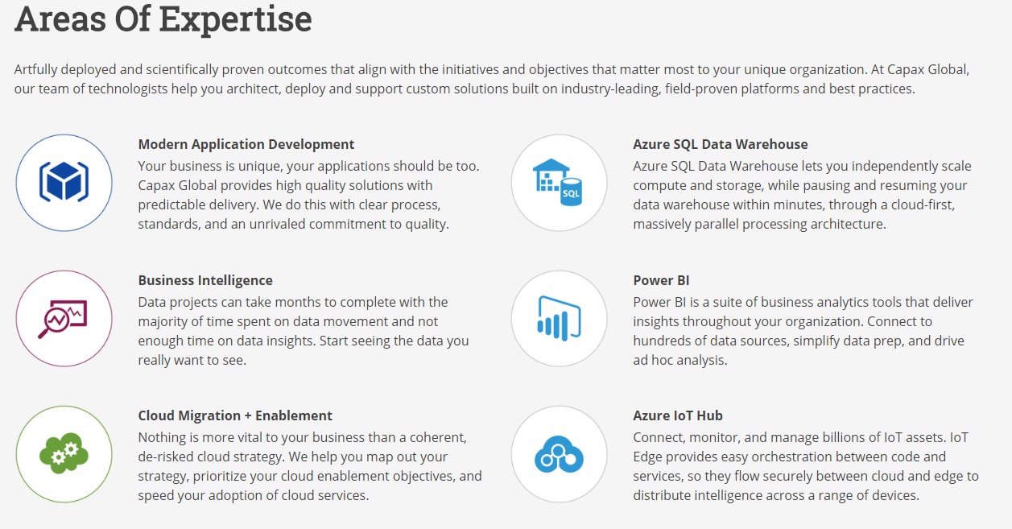
Built on the premise that professional, experienced senior technologists will deliver higher quality results, faster and with less risk, than our competitors.

Slide 4

Warning
Opinions Ahead

Slide 5
What are we talking about?
QnA Maker
Azure Text Analytics API
Language Understanding LUIS
What we’re not talking about:
Linguistic Analysis API – Analyze Text Structure, effectively moving to Azure Machine Learning Studio.

Slide 6
What is QnA Maker?
Microsoft
“Build, train and publish a simple question and answer bot based on FAQ URLs, structured documents, product manuals or editorial content in minutes.”
Jim
“FAQ-as-a-service: A list of questions and answers and some intelligence to go find them.”

Slide 7
What is the Azure Text Analytics API?
Microsoft
“Detect sentiment, key phrases, and language from your text.”
Jim
“A Software-as-a-Service microservice which you use to extract language, phrases, entities, and sentiment from natural language input.”

Slide 8
What is LUIS?
Microsoft
“A machine learning-based service to build natural language into apps, bots, and IoT devices. Quickly create enterprise-ready, custom models that continuously improve.”
Jim
“A Software-as-a-Service microservice which you use to extract the intent and domain entities from natural language input.”
Notes:
I don’t like that this is forced into “apps, bots, and IoT devices”.

Slide 9
LUIS and Text Analytics – Side by Side
Feature | LUIS | Text Analytics API
Multiple Languages | Separate Apps | Yes
Entity Extraction | Yes | Yes
Sentiment Analysis | Yes (Custom or add on) | Yes
Language Detection | No | Yes
Speech Support | Yes (Higher cost/tx) | No (Chain with Speech to Text)
Batch | No | Yes
Domain Specific | Yes | No

Slide 10
Example Call Flow

Slide 11
The Three Main LUIS Objects
Intents - An intent represents a task or action the user wants to perform.
Utterances - Utterances are input from the user that your app needs to interpret.
Entities - The entity represents a word or phrase inside the utterance that you want extracted.

Slide 12
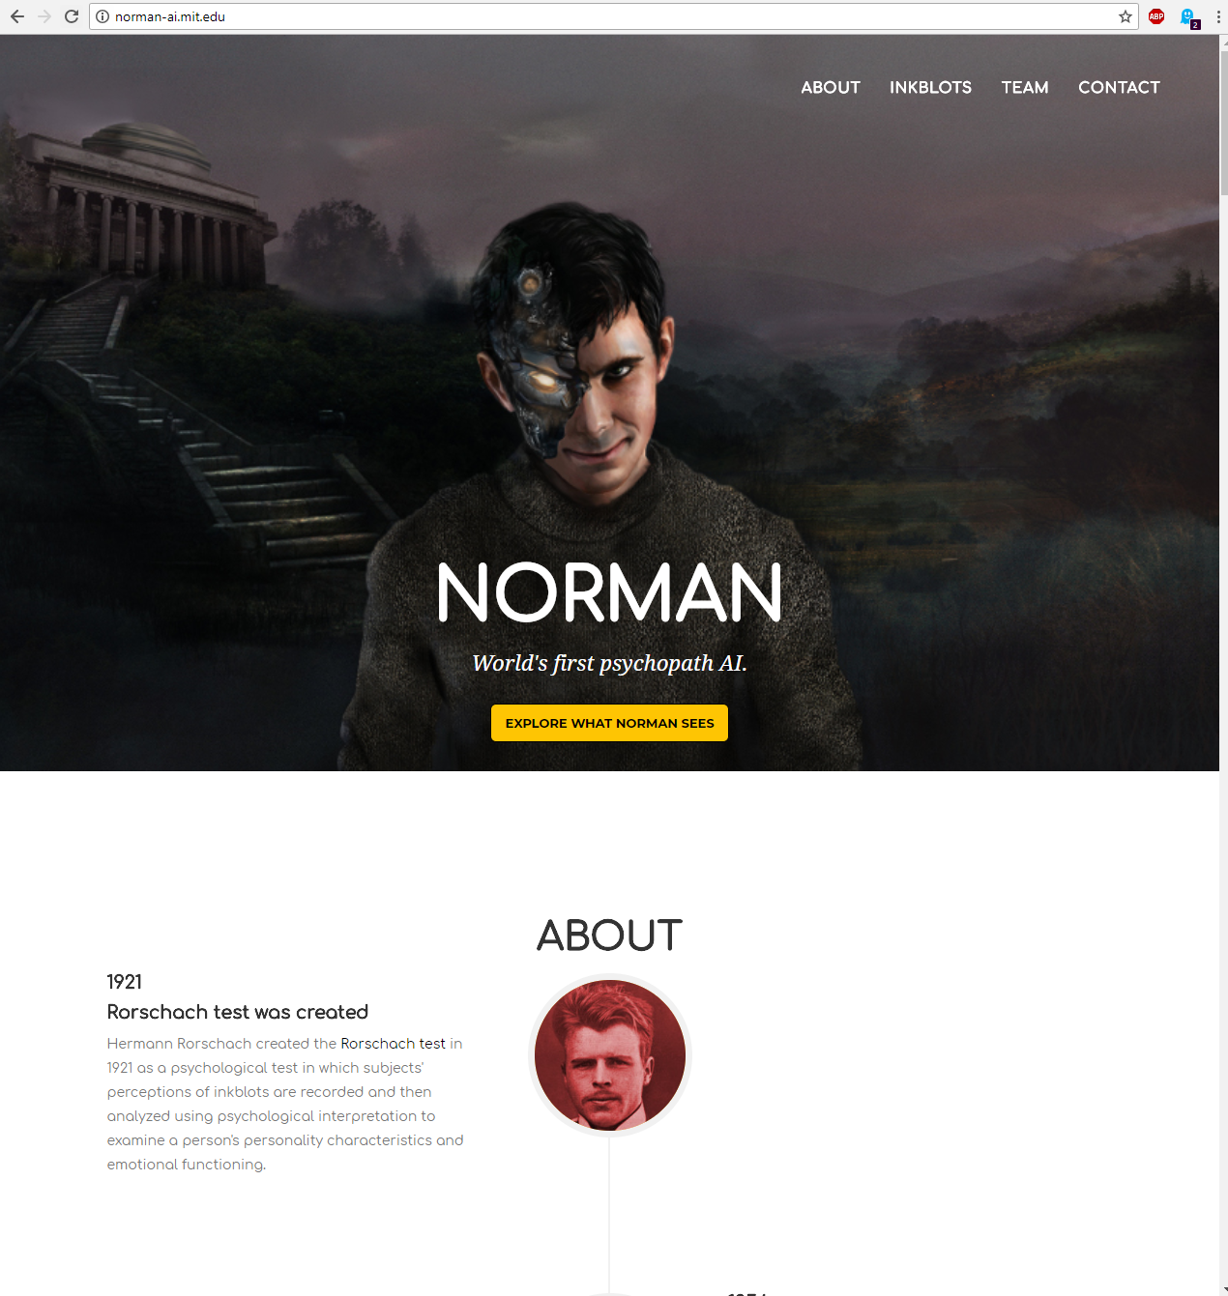
Intents and the Importance of None
Notes:
The None intent is used to classify utterances that don’t match an intent. If you don’t put at least a few things here, then your app may match any random utterance to one of the intents you are trying to discover. So, put at least something here.

Slide 13
Handy References
LUIS
https://www.luis.ai/
LUIS EndPoint API
https://westus.dev.cognitive.microsoft.com/docs/services/5819c76f40a6350ce09de1ac/operations/5819c77140a63516d81aee78
QnA MAker
https://www.qnamaker.ai/
Some Source code:
https://github.com/jimontheriver/textanalyticsexample

